Slide 1


郑凯文
2018 - 10 - 09
SCISSOR: Scalable and Efficient Reachability Query
Processing in Time-Evolving Hierarchies
Notes:
时间演化层次结构中的可扩展且高效的可达性查询处理
SCISSOR
（selective snapshot indexing with progressive solution refinement）
（使用渐进式解决方案细化的选择性快照索引）
Phani Rohit Mullangi 是佐治亚大学的博士研究生。专长是大规模的分布式计算和数据管理。我目前在Skytap的工作包括为企业消费的云构建监控基础设施。
下面简要介绍我的背景和技能：
- 佐治亚大学计算机科学博士
- 在分布式系统和虚拟化方面的丰富经验（ESX，Vcenter等）
- 构建云规模系统的经验
构建监控基础设施。我的背景的简单总结一...
Lakshmish Ramaswamy 雅典乔治亚大学格鲁吉亚信息学院计算机科学教授兼副主任 印度人 主要研究数据管理 数据分析

Slide 2
OUTLINE
1
Introduction
2
Exist Approach
3
Our Approach
4
Experiments & Results
5
Conclusion

Slide 3
Introduction
Background
XML Documents || Software Versioning System
Edit(1,2)
Edit(2,3)
SNAPSHOT - 1
SNAPSHOT - 2
SNAPSHOT - 3
Time

Slide 4

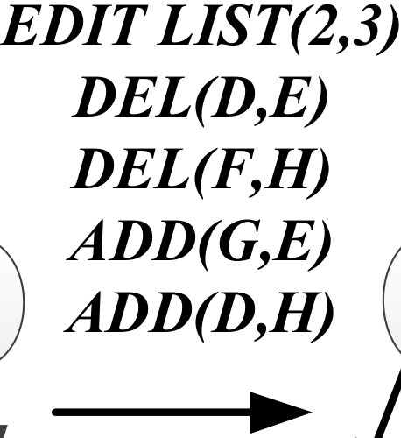
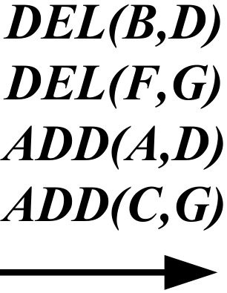
Introduction
Definition
Time-Evolving Hierarchies (TEHs)
snapshot-specific reachability query (SSReach)
A
A
A
B
F
B
F
D
B
F
D
C
D
G
H
C
H
E
C
H
E
G
G
SNAPSHOT - 1
SNAPSHOT - 2
E
SNAPSHOT - 3
SSReach( v , w , S)
SSReach ( B, E , S₃ )
4/34

Slide 5
Preliminaries
Reachability in Static Trees By Traversal Apporach
A
Q(A,E)
E.p = D
D.p = B
B.p = A
return TRUE
B
F
C
D
G
H
E
5/34

Slide 6
Preliminaries
Interval-based Indexing for Reachability in Static Trees
Q(A,E)
A.pre = 0
A.post = 15
E.pre = 5
E.post = 6
A.pre <= E.pre && E.post <= A.post
return TRUE
A
0
15
B
F
1
8
9
14
C
D
G
H
2
3
4
7
10
11
12
13
E
5
6
6/34

Slide 7
OUTLINE
1
Introduction
2
Exist Approach
3
Our Approach
4
Experiments & Results
5
Conclusion

Slide 8
Exist Approach
I Index No Snapshot(INS)
Time-Evolving Hierarchies (TEHs)
A
A
A
B
F
B
F
D
B
F
D
Edit(1,2)
Edit(2,3)
C
D
G
H
C
H
E
C
H
E
G
G
SNAPSHOT - 1
SNAPSHOT - 2
E
SNAPSHOT - 3
SSReach( v , w , S)
answered by an on-demand traversal
Problem : very high query time
7/34
Notes:
通过按需遍历回答
非常高的查询延迟

Slide 9
Exist Approach
II Index All Snapshot (IAS)
Time-Evolving Hierarchies (TEHs)
A
0
A
15
0
A
15
0
15
B
D
1
B
8
F
14
B
F
D
1
8
F
11
14
9
1
6
11
14
Edit(1,2)
7
10
Edit(2,3)
9
10
C
D
G
H
C
H
E
2
C
7
H
2
3
4
7
12
13
2
5
8
9
13
12
13
10
11
12
5
E
G
3
G
6
6
3
4
SNAPSHOT - 1
SNAPSHOT - 2
4
E
5
SSReach ( v , w , S )
SNAPSHOT - 3
index every snapshot of the TEH using interval-based indexing
Problem：① computational very high(for Indexing every snapshot)；
② storage overheads are going to be high；
③ few queries on some snapshots, waste both storage and computation；
④ can't control over the indexing costs vs. query efficiency tradeoff；
Notes:
问题：①计算量很高（用于索引每个快照）;
②存储开销会很高;
③对一些快照的查询很少，浪费了存储和计算;
④无法控制索引成本与查询效率的权衡;

Slide 10
OUTLINE
1
Introduction
2
Exist Approach
3
Our Approach
4
Experiments & Results
5
Conclusion & Future Work

Slide 11
Our Approach
SCISSOR
（selective snapshot indexing with progressive solution refinement）
Balance
between
query processing efficiency
and
indexing costs
11/34
Notes:
选择性快照索引与渐进式解决方案细化
平衡查询处理效率和索引成本

Slide 12
Our Approach
SCISSOR
0
A
15
A
A
1
B
8
9
F
14
B
B
F
D
F
D
2
C
3
4
D
7
G
H
C
H
E
C
H
10
11
12
13
E
G
G
5
6
SNAPSHOT - 1
SNAPSHOT - 2
E
SNAPSHOT - 3
SSReach( v , w , S) Suppose S₁ is indexed
SSReach ( B, E , S₃ )
Main Idea：
① Index only partial snapshots;
② Find the indexed snapshot closest to the target snapshot;
③ Check the reachability between v& w in the indexed snapshot;
④ Analyze the edit sequence between S₁ & S₃ determine the v & w reachability;
12/34
Notes:
选择性快照索引与渐进式解决方案细化
主要思想：
①仅索引部分快照;
②查找最接近目标快照的索引快照;
③检查索引快照中v＆w之间的可达性;
④分析索引快照和目标快照之间编辑序列对目标顶点可达性的影响;

Slide 13
Our Approach
SCISSOR
0
A
15
A
A
1
B
8
9
F
14
B
B
F
D
F
D
2
C
3
4
D
7
G
H
C
H
E
C
H
10
11
12
13
E
G
G
5
6
SNAPSHOT - 1
SNAPSHOT - 2
E
SNAPSHOT - 3
SSReach( v , w , S)
if v → w in indexed SNAPSHOT
ImList(v, w) = {w and all ancestors of w until vertex v};
DELETE
ImList(v, w)
(impact list)
if v w in indexed SNAPSHOT
ImList(v, w) = {w until the root of w’s tree};
ADD
13/34
Notes:
影响列表，

Slide 14
Our Approach
SCISSOR
0
A
15
A
A
1
B
8
9
F
14
B
B
F
D
F
D
2
C
3
4
D
7
G
H
C
H
E
C
H
10
11
12
13
E
G
G
5
6
SNAPSHOT - 1
SNAPSHOT - 2
E
SNAPSHOT - 3
SSReach( v , w , S) Suppose S₁ is indexed
CEDList(S₃)(Edit list) ：
contains all the edits occurring between the snapshot S₁ (temporally closest indexed snapshot) and snapshot S₃;
14/34

Slide 15
Our Approach
SCISSOR
0
A
15
A
A
1
B
8
9
F
14
B
B
F
D
F
D
2
C
3
4
D
7
G
H
C
H
E
C
H
10
11
12
13
E
G
G
5
6
SNAPSHOT - 1
SNAPSHOT - 2
E
SNAPSHOT - 3
CANList(current ancestor list)：
CANList(u) refers to the current stage of the entry algorithm, and some editors may affect the ancestors of u. Then the CANList(u) stores the ancestor vertices of u in the current state.
CANList(E) = {D , B , A};
DEL(B,D)
CANList(E) = {D};
15/34
Notes:
CANList(u) 是指进入算法的当前阶段中，一些编辑也许影响到了u的祖先。那么CANList（u）中存的就是当前状态下u的祖先顶点。

Slide 16
SCISSOR
Our Approach
0
A
15
A
A
1
B
8
9
F
14
B
B
F
D
F
D
2
C
3
4
D
7
G
H
C
H
E
C
H
10
11
12
13
E
G
G
5
6
SNAPSHOT - 1
SNAPSHOT - 2
E
SNAPSHOT - 3
ImList(v, w)(impact list)
CEDList(q+a)(Edit list)
CANList(current ancestor list)
Reachability_Status(TRUE or FALSE)
16/34
Notes:
CANList(u) 是指进入算法的当前阶段中，一些编辑也许影响到了u的祖先。那么CANList（u）中存的就是当前状态下u的祖先顶点。

Slide 17
Our Approach
CEDList←Initiallize & Pre-Process edits between q & q+a
SCISSOR
Step1
SSReach( v , w , q+a)
N
Y
w is in snapshot q
Y
Y
CEDList contains Add(w)
v → w in snapshot q
ImList ← w
Reachability_Status ← false
N
N
0
A
15
A
Reachability_Status ← false
exit
Reachability_Status ← false
ImList ← fetchAncestors(w)
1
B
8
9
F
14
B
F
D
CEDList(q+a)
ImList (v,w)
Reachability_Status
Reachability_Status ← true
ImList ← fetchAncestors(v,w)
2
C
3
4
D
7
G
H
C
H
E
10
11
12
13
E
G
5
6
SNAPSHOT - 1
SNAPSHOT - 2
17/34
Notes:
预处理就是指 去除 编辑序列自相矛盾的编辑对（Delete A,B Add A,B）

Slide 18
0
A
15
A
A
1
B
8
9
F
14
B
B
F
D
F
D
2
C
3
4
D
7
G
H
C
H
E
C
H
10
11
12
13
E
G
G
5
6
SNAPSHOT - 1（S1）
SNAPSHOT - 2（S2）
E
SSReach( B, E , S3) S1 is indexed
SNAPSHOT - 3（S3）
① CEDList←Initiallize & Pre-Process edits between S1 & S3
② E is in snapshot q ？
③ B → E in snapshot q？
CEDList(S3)={ DEL(B,D), DEL(F,G), DEL(D,E), DEL(F,H),
ADD(A,D), ADD(C,G), ADD(G,E), ADD(D,H)};
Reachability_Status ← true CANList(E)={ D , B , A };
ImList ← fetchAncestors(B,E)
ImList = {E，D};
18/34
Notes:
CANList(u) 是指进入算法的当前阶段中，一些编辑也许影响到了u的祖先。那么CANList（u）中存的就是当前状态下u的祖先顶点。

Slide 19
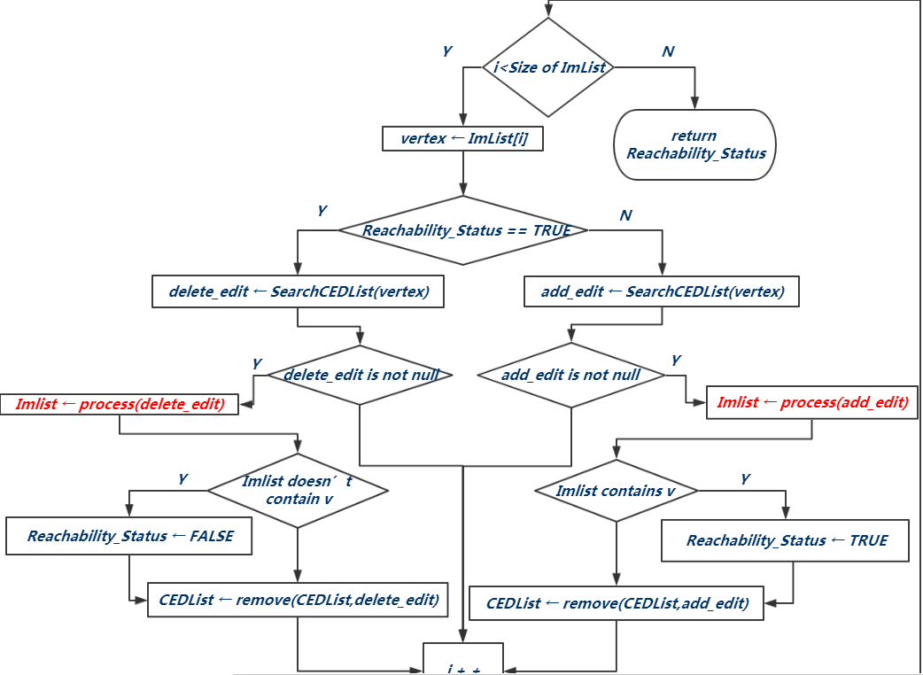
Our Approach
SCISSOR
Step2
SSReach( v , w , q+a)
process(delete_edit)
process(add_edit)
10/23
Notes:
每次迭代中 当ImList 发生变化后 都要从第一个列表元素开始处理

Slide 20
0
A
15
A
A
1
B
8
9
F
14
B
B
F
D
F
D
2
C
3
4
D
7
G
H
C
H
E
C
H
10
11
12
13
E
G
G
5
6
SNAPSHOT - 1（S1）
SNAPSHOT - 2（S2）
E
SSReach( B, E , S3) S1 is indexed
SNAPSHOT - 3（S3）
CEDList(S3)={ DEL(B,D), DEL(F,G), DEL(D,E), DEL(F,H),
ADD(A,D), ADD(C,G), ADD(G,E), ADD(D,H)};
Reachability_Status ← true CANList(E)={ D , B , A };
ImList = {E，D}; vertex ← ImList[i] = E；
④ delete_edit ← SearchCEDList(E)
process(delete_edit):
20/34
Notes:
CANList(u) 是指进入算法的当前阶段中，一些编辑也许影响到了u的祖先。那么CANList（u）中存的就是当前状态下u的祖先顶点。

Slide 21
Our Approach
SCISSOR
SSReach( v , w , q+a)
remove all vertices beyond k
(not excluding k) from ImList
update the CANList for each descendant of k
process(delete_edit)
Set Reachability_Status to FALSE and delete the edit itself from CEDList
22/34
Notes:
CANList(u) 是指进入算法的当前阶段中，一些编辑也许影响到了u的祖先。那么CANList（u）中存的就是当前状态下u的祖先顶点。

Slide 22
0
A
15
A
A
1
B
8
9
F
14
B
B
F
D
F
D
2
C
3
4
D
7
G
H
C
H
E
C
H
10
11
12
13
E
G
G
5
6
SNAPSHOT - 1（S1）
SNAPSHOT - 2（S2）
E
SSReach( B, E , S3) S1 is indexed
SNAPSHOT - 3（S3）
CEDList(S3)={ DEL(B,D), DEL(F,G), DEL(D,E), DEL(F,H),
ADD(A,D), ADD(C,G), ADD(G,E), ADD(D,H)};
Reachability_Status ← true
ImList = {E，D};
④ delete_edit ← SearchCEDList(E)
process(delete_edit):
ImList = {E};
Reachability_Status ← false
23/34
Notes:
CANList(u) 是指进入算法的当前阶段中，一些编辑也许影响到了u的祖先。那么CANList（u）中存的就是当前状态下u的祖先顶点。

Slide 23
0
A
15
A
A
1
B
8
9
F
14
B
B
F
D
F
D
2
C
3
4
D
7
G
H
C
H
E
C
H
10
11
12
13
E
G
G
5
6
SNAPSHOT - 1（S1）
SNAPSHOT - 2（S2）
E
SSReach( B, E , S3) S1 is indexed
SNAPSHOT - 3（S3）
CEDList(S3)={ DEL(B,D), DEL(F,G), DEL(D,E), DEL(F,H),
ADD(A,D), ADD(C,G), ADD(G,E), ADD(D,H)};
Reachability_Status ← false
ImList = {E};
vertex ← ImList[i] = E；
⑤ add_edit ← SearchCEDList(E)
process(add_edit):
23/34
Notes:
CANList(u) 是指进入算法的当前阶段中，一些编辑也许影响到了u的祖先。那么CANList（u）中存的就是当前状态下u的祖先顶点。

Slide 24
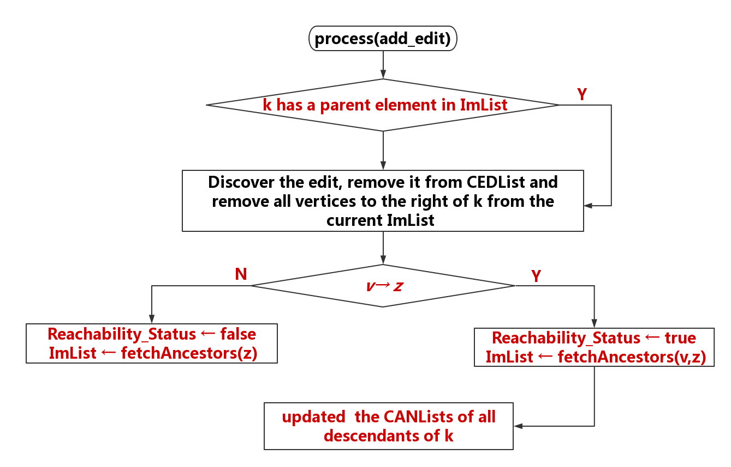
Our Approach
SCISSOR
SSReach( v , w , S)
(Must have an unhandled delete edit)
process(add_edit)
add (z,k)
(this can be done by checking CANList(z))
24/34
Notes:
保持树的属性(Must have an unhandled delete edit)

Slide 25
0
A
15
A
A
1
B
8
9
F
14
B
B
F
D
F
D
2
C
3
4
D
7
G
H
C
H
E
C
H
10
11
12
13
E
G
G
5
6
SNAPSHOT - 1（S1）
SNAPSHOT - 2（S2）
E
SSReach( B, E , S3) S1 is indexed
SNAPSHOT - 3（S3）
CEDList(S3)={ DEL(B,D), DEL(F,G), DEL(D,E), DEL(F,H),
ADD(A,D), ADD(C,G), ADD(G,E), ADD(D,H)};
Reachability_Status ← false
ImList = {E};
⑤ add_edit ← SearchCEDList(E)
CANList(G)={ F , A };
process(add_edit):
ImList = {E , G , F , A}; Reachability_Status ← false
25/34
Notes:
CANList(u) 是指进入算法的当前阶段中，一些编辑也许影响到了u的祖先。那么CANList（u）中存的就是当前状态下u的祖先顶点。

Slide 26
0
A
15
A
A
1
B
8
9
F
14
B
B
F
D
F
D
2
C
3
4
D
7
G
H
C
H
E
C
H
10
11
12
13
E
G
G
5
6
SNAPSHOT - 1（S1）
SNAPSHOT - 2（S2）
E
SSReach( B, E , S3) S1 is indexed
SNAPSHOT - 3（S3）
CEDList(S3)={ DEL(B,D), DEL(F,G), DEL(D,E), DEL(F,H),
ADD(A,D), ADD(C,G), ADD(G,E), ADD(D,H)};
Reachability_Status ← false
ImList = {E , G , F , A};
vertex ← ImList[i] = E；
vertex ← ImList[i] = G；
⑤ add_edit ← SearchCEDList(G)
CANList(G)={ F , A };
process(add_edit):
CANList(C)={ B , A };
ImList = {E , G , C};
ImList = {E , G};
Reachability_Status ← true
26/34
Notes:
CANList(u) 是指进入算法的当前阶段中，一些编辑也许影响到了u的祖先。那么CANList（u）中存的就是当前状态下u的祖先顶点。

Slide 27
0
A
15
A
A
1
B
8
9
F
14
B
B
F
D
F
D
2
C
3
4
D
7
G
H
C
H
E
C
H
10
11
12
13
E
G
G
5
6
SNAPSHOT - 1（S1）
SNAPSHOT - 2（S2）
E
SSReach( B, E , S3) S1 is indexed
SNAPSHOT - 3（S3）
CEDList(S3)={ DEL(B,D), DEL(F,G), DEL(D,E), DEL(F,H),
ADD(A,D), ADD(C,G), ADD(G,E), ADD(D,H)};
Reachability_Status ← true
ImList = {E , G , C};
vertex ← ImList[i] = E；
vertex ← ImList[i] = G；
vertex ← ImList[i] = C；
Return Reachability_Status;
END Approach;
our algorithm does not process edits that are clearly irrelevant to the query thereby avoiding unnecessary overheads.
27/34
Notes:
CANList(u) 是指进入算法的当前阶段中，一些编辑也许影响到了u的祖先。那么CANList（u）中存的就是当前状态下u的祖先顶点。

Slide 28
OUTLINE
1
Introduction
2
Exist Approach
3
Our Approach
4
Experiments & Results
5
Conclusion & Future Work

Slide 29
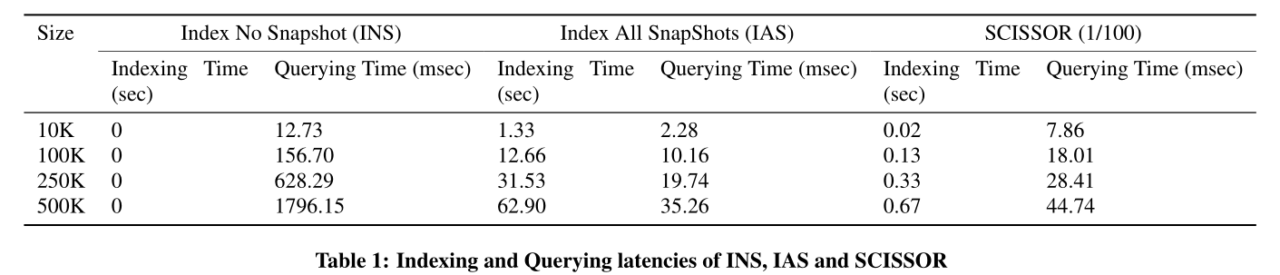
Experiments & Results
vertices
height of all hierarchies is set to 10
The total number of snapshots for each TEH in this experiment is 100
executing 10000 randomly queries
29/34

Slide 30
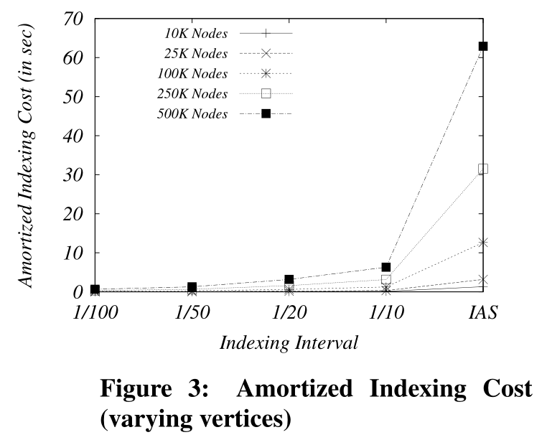
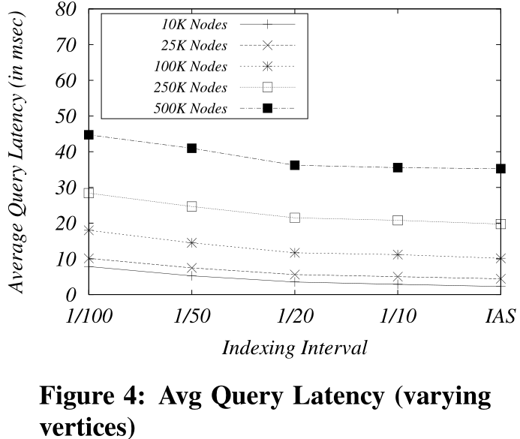
Experiments & Results
30/34

Slide 31
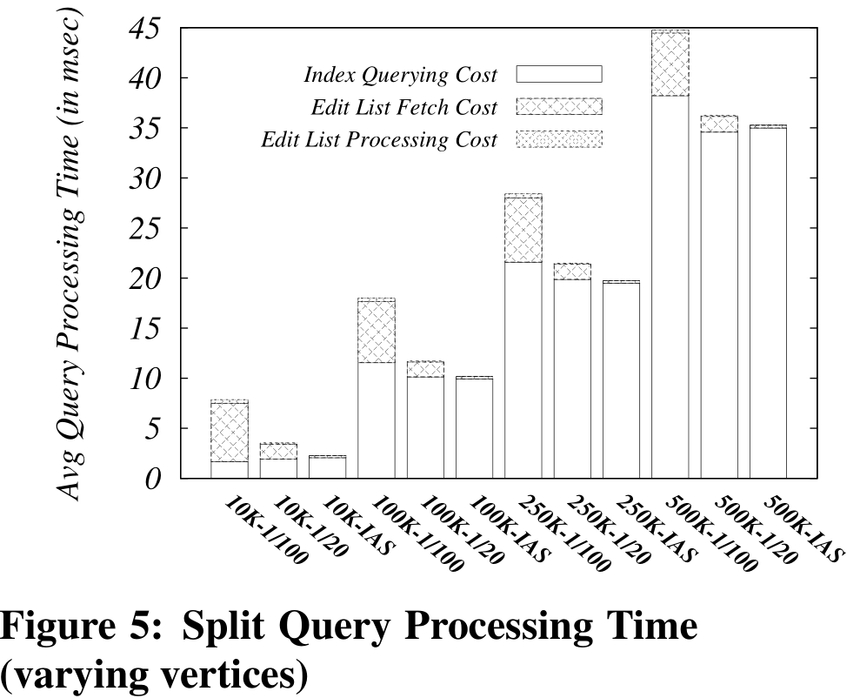
Experiments & Results
31/34

Slide 32
OUTLINE
1
Introduction
2
Exist Approach
3
Our Approach
4
Experiments & Results
5
Conclusion

Slide 33
Conclusion
Efficient and scalable processing of reachability queries in time-evolving hierarchies is important for many modern applications.
This paper presented a tunable, time and space efficient framework called SCISSOR for testing reachability between given pair of vertices on any given snapshot of a TEH.
The main idea behind SCISSOR is to selectively index a subset of TEH snapshots and use these snapshot indexes to answer reachability queries on all snapshots of the TEH.
33/34
Notes:
对于许多现代应用程序来说，在时间推移层次结构中对可达性查询进行高效且可扩展的处理非常重要。
在本文中，我们提出了一个可调，时间和空间有效的框架，称为SCISSOR，用于测试TEH任何给定快照上给定顶点对之间的可达性。
SCISSOR背后的主要思想是有选择地索引TEH快照的子集，并使用这些快照索引来回应TEH的所有快照上的可达性查询。

Slide 34
Thank You!

